Slide 1
Summary of our engagement across key programs in CTS
IAC infra projects setup & managing delivery of Infra deployments
Bulk migration of apps from AQ6 to AQ7 hosts
Hosting Capacity analysis, ordering & configuring new Linux AQ7 sets
Provisioning E-TRADE Infra setup in WF+ & Zapp
Enhanced the IaC stability by adding pre-validation checks against input yaml schema at CD stage
1
Integration
Engineering
2
Containerization of BPM/ODM & CI/CD enablement viz. Ansible, Train & TeamCity
Automated Releases cutoff & activity creation for ODM Rule projects using Java, Ant Tasks & Ansible
Migration of 11 ODM RuleProjects to 8.10.2 in non-prod & prod environments
Enhancement in security setup for ODM RuleProjects using LDAP/ACL groups
Platform
Engineering
3
Support Hadoop based deployments through CDSS
Integrate KPI & Metrics deployment dashboards
SPA Wizard integration for Public cloud deployments
Improved accuracy of application performance statistics calculation using Machine Learning
Strong focus on Process Automation and Developer
Self-Service
SDLC
Automation
4
Capacity
Metrics
Identify web farm server sets which are underutilized, can be reserved for new site deployment
Webfarm/Windeploy servers utilization report
Site to server mapping data for reference
5
Private
Cloud
Successfully deployed .NETCore, Java Spring apps on Treadmill platform using “EOD” Blueprint templates
Enhanced reusablity in automation script by embedding logic for deploying Batch Jobs as Docker containers
Deploying WMPC Proxies & Swagger endpoints using APIGEE CI/CD Automation (viz. /apiproxy json templates)

Slide 2
SRE Journey – DevOps to SRE
- Several opportunities to enhance SRE Best Practices in DevOps framework
Plan
Code,Build, Test
Deploy, Release
Monitor
Operate
Support & maintain-ability are an afterthought
Rules on Production mgmt. engagement are not clear
Lack of consistency on collaboration b/w Dev, QA & Prod environments
Lack of best practices on intutive & predictive monitoring approaches
Monitoring as Code is not adopted
Resiliency testing not fully covered
Limited & late feedback to Dev teams from QA/PM
No Continuous Deployment for Capacity,QA & Platform automation configs
No AI/ML driven Hygiene playbook(e.g., upgrade of components to latest ver.) as part of daily work
Prod mgmt. Functions engaged late into the lifecycle
Limited Proactive & predictive Post-Deploy Validations/checkouts
Backouts not systematically tested
Less intuitive Analytics Dashboards
Runbook automations not fully implemented in vertical functions/PAGs
During Incident mgmt, Event Correlation is less mature
Post-mortem practices are not covered
Very limited use of Synthetic transaction testing (like healthchecks)
Limited operational reliablity assurance & validations
Less Aggregations , Trends & Patterns based Analysis for intrumenting Prod level monitoring & measuring key-metrics
No AI/ML infused Alerts Handling ecosystem
Limited Operational Dashboards & data models for Ingestion & ETL Transformation
End to End
Artifical Intelligent
Automated
Agile
Machine Learning
Business 4.0 Ecosystem

Slide 3

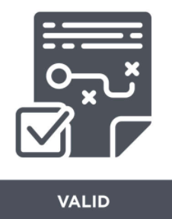








SRE Journey – SRE Accelerators on top of current ecosystem
- SRE Model enabling Prod mgmt best practices through SDLC Lifecycle
Plan
Code,Build, Test
Deploy, Release
Monitor
Operate
Define SLOs like a user
Fail sanely (Sanitize & validate inputs)
Prod level monitoring for non-prod envs
Monitoring thru tools tracking SLIs metrcis & pre-defined implied actions
Blameless Post-mortem
focusing on Process & Tech
Define minimal monitoring & recoverability requirement
Resiliency Testing
Platform/Capacity configs automated deployments
Operational Work (<50% efforts on operational tasks)
Overloads & failure analysis
Implanting "Monitoring-As-a-Code" for annotating rollout of the SRE functions, scripts & configs viz. Devops (CI/CD) pipelines. These AIOps SRE artifacts & manifests will drive the Testing Framework, Platform, Operational Support etc. automations viz. AI/ML written intelliGen Ansible Playbooks, Flask-API/Microservices, QA load & regression workflows, Data analytics dashboards (data-models/Streamsets) ​​
Embedding (AI/ML-driven) SRE accelerators as Horizontal functions - Spawning SRE coverage across the PAGs/Lifecycle management to build SRE ecosystem​ viz. Integrated Incident mgmt wireframes, Proactive Monitoring, Predictive Alerts analysis & Dynamic setup of alert Thresholds (Plant healthchecks, RFB checkouts & Hygiene items viz. RPA/RBA/Halo-Cache rules engine) ​
End to End
Artifical Intelligent
Automated
Agile
Machine Learning
Business 4.0 Ecosystem

Slide 4
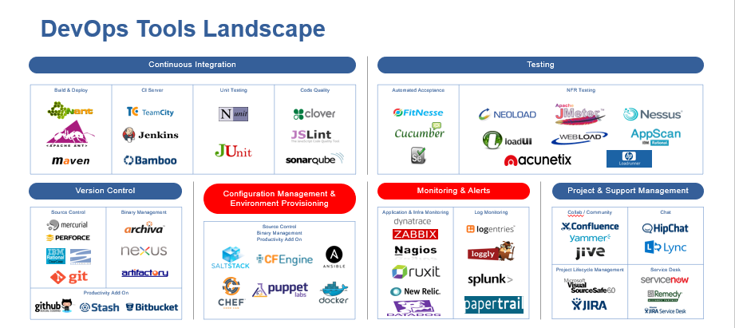

SRE/DevOps Tools Landscape

Slide 5







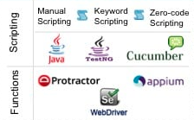


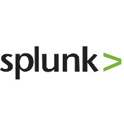


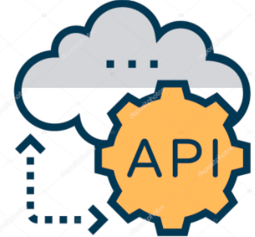
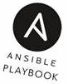





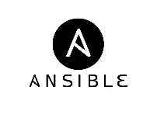


SRE Implementation Proposed Architecture
- SRE Ecosystem Wired Layout based on top of existing environment in MSWM
SRE Coverage
(Lifecycle Management)
Project Management (Dev + Ops + Eng.)
Ideation
Elicit Requirements
Develop Story
Backlog
Stories Backlog
Platform
Engineering
Stories Backlog Grooming
Release Planning
Estimate Delivery Efforts
Prioritize Backlog Items
Pick Prioritized Items
Create Release Backlog
Groom Release Backlog
Operations
Feedback
In-House Tools
Reliability & Upgradation
Environment Setup viz. Managed Platform/SnaP APIs)
Version Control
Build Automation [Resource Compute Validations viz. Spring Cloud Configs]
Build
(input yamls to provision Infra/Containers/DB/etc.)
Execute Testing Scripts
Generate SDLC Reports
Deploy To Staging Env.
Install modules, artifacts, Feeds
Validate
Environment
Performance Management
Proposed SRE
Proposed SRE
Continuous Deployment Automation (CDSS/IaC/PrivateCloud)
ITSM
Capacity Management
Platform Eng. Automation
(Diagnostic & Self-Healing Capabilities)
Testing Automation
Engine
Pre-Deploy Validations
Deploy Infra/Apps to Non-Prod (viz. Infra Tkts) &
Prod (viz. CDSS/DevCentral)
Post-Deploy Checkouts
Create Testing Plan
Create Testing Functions & Scripts
Rel & Change Management
Environment Standardization
CI/CD for ODM & BPM Containers (ex: IBM Ace)
Proposed SRE
QA Load & Regression Flows
Operational Support Automation | Monitor-Analyse-Operate (SRE Accelerators)
Bug & Defect Tracking
Platform Upgradation & Configs Based Rollouts
Continuous Deployment for Apache Solr Configs & Infra
Operational
Adoption Rates
Dashboard
Monitoring
Instrumentation of all env
Measure Key Metrics & Alert Handling viz AI/ML
Detect & Fix Prod Issues
Runbook &
Hygiene
Checkouts
Incident
Management
Continuous Monitoring of Web & DB Connectors
Anomaly Detection & Correction viz. Analytics & Data Modelling
ENGINE REST API
Notes:
Rahul

